Slide 1

Drowsiness and Yawn Detection
Using Python.
Zenia Nouphal
Aditi Pradhan

Slide 2
Introduction
Tech Stack:
Programming language: Python
Libraries:
scipy: for distance calculations.
imutils: for video stream handling and image processing.
dlib: for facial landmark detection.
OpenCV: for computer vision tasks.
numpy: for numerical operations.
os: for system-level operations.
argparse: for command-line argument parsing.
threading: for managing threads.
Text-to-speech tool:
espeak: for generating alarm messages.
The code implements a drowsiness and a yawning detection system using webcam feed.
Its uses computer vision and facial landmark detection techniques to monitor the driver’s face for signs of drowsiness and yawning.
When drowsiness or yawning is detected, the code triggers an alarm message.

Slide 3
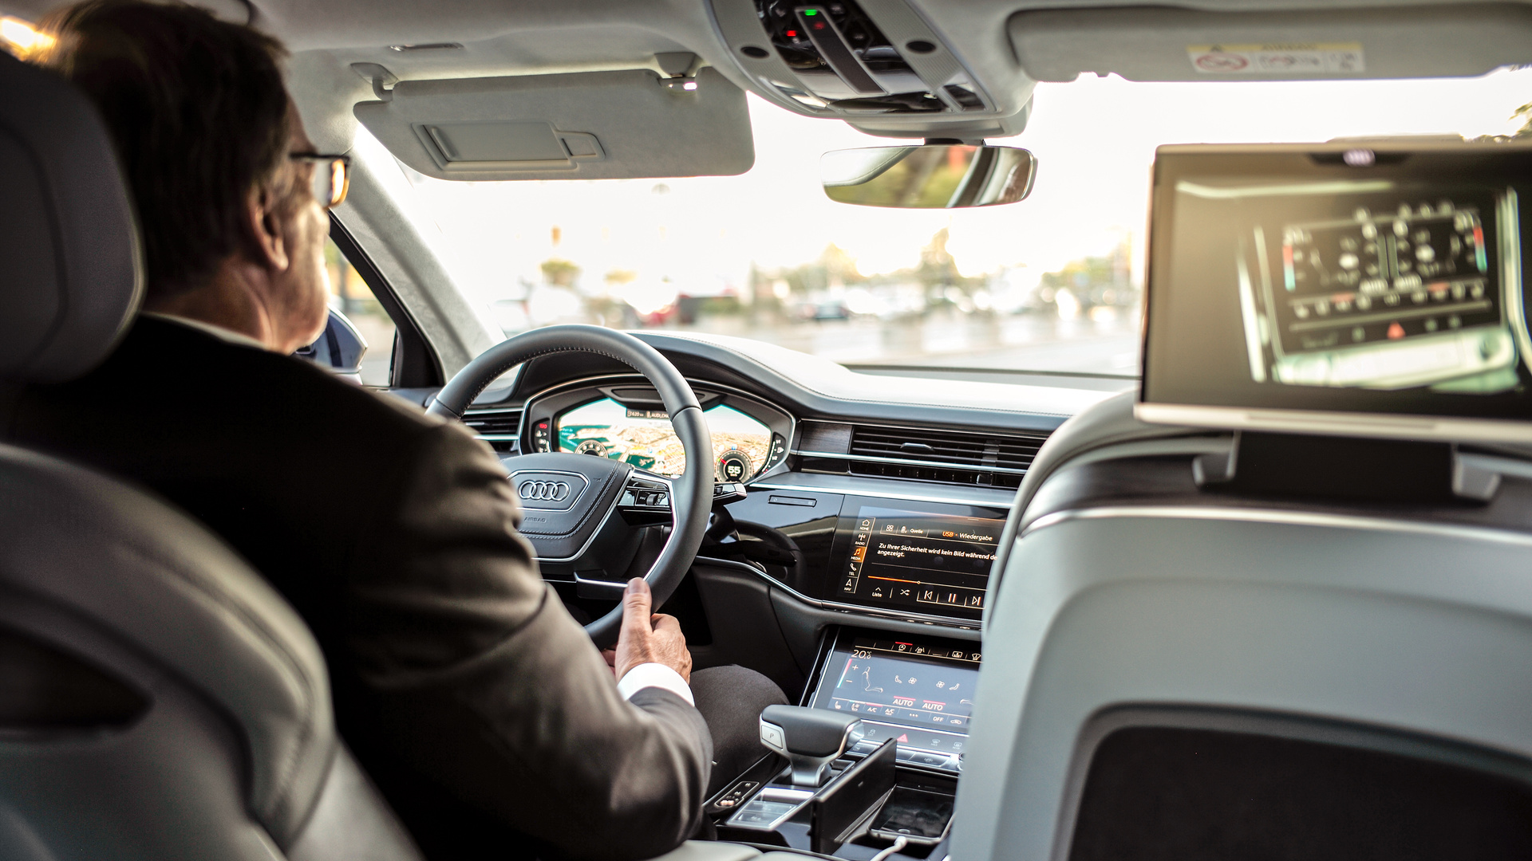
Solution Overview
A drowsiness detection solution is a technology-driven system designed to monitor and alert individuals when they show signs of drowsiness, especially in contexts like driving, working, or operating heavy machinery. The primary goal is to prevent accidents and enhance safety by providing timely warnings to prevent potentially dangerous situations.

Slide 4
Project
Overview

Slide 5

The code defines several functions:
alarm(msg): Used to trigger the alarm message.
eye_aspect_ratio(eye): Calculates the Eye Aspect Ratio (EAR) based on eye landmarks.
final_ear(shape): Calculates the final EAR by averaging the EARs of both eyes.
lip_distance(shape): Calculates the distance between the upper and lower lips for yawning detection.
01
It sets various constants, including thresholds for EAR and yawning detection, and initializes global variables for alarm status and counters.
The script loads the Haar Cascade Classifier for face detection and the facial landmarks predictor (’shape_predictor_68_face_landmarks.dat’ file).
02
Flow of
Code
It starts a video stream from the webcam using ‘VideoStream‘ and processes each frame in loop.
The code detects faces using the Haar Cascade Classifier and obtains facial landmarks using dlib.
It calculates the EAR and lip distance to determine the drowsiness and yawning.
If drowsiness or yawning is detected, it triggers an alarm message using the ‘alarm‘ function.
The status of alarm is controlled using threads to avoid blocking main loop.
The frame is displayed with relevant text.
03
04
The program can be terminated by pressing the ‘q‘ key.
After exiting the loop, the video stream and OpenCV windows are closed.

Slide 6


Impact of the project
Road Safety
In the context of driving, these solutions can prevent accidents caused by drowsy drivers, potentially saving lives and reducing road-related fatalities.
Workplace Safety
Drowsiness detection is crucial in industries where heavy machinery or critical tasks are involved, reducing the risk of accidents due to impaired alertness.
Health and Well-being
The system can promote awareness of the importance of adequate rest and sleep, contributing to better health and overall well-being.

Slide 7


Impact of the project
Reduced Productivity Loss
In professional settings, it can help prevent productivity loss due to reduced focus and alertness, ultimately benefiting businesses.
User Education
By providing users with insights into their alertness patterns, the solution can encourage healthier habits and lifestyle changes.

Slide 8



Market Prospects
Automotive Safety
Insurance Industry
Transportation and Logistics
Consumer Market
Drowsy driving is a significant factor in road accidents. As governments and organizations focus on improving road safety, there is a growing demand for technologies that can help prevent accidents caused by drowsy drivers. This model can be integrated into vehicles as part of advanced safety systems.
Insurance companies are increasingly interested in promoting safe driving practices. This model can be used to incentivize safe driving behavior and offer discounts to policyholders who use the system.
Some consumers may opt to use this system as an aftermarket product for their personal vehicles, especially those who frequently drive long distances or work as rideshare drivers.
Long-haul trucking and transportation companies can benefit from this technology to reduce accidents and improve the safety of their drivers.

Slide 9



Market Prospects
Regulatory Compliance
Partnerships
Global Reach
Public Awareness
Collaboration with vehicle manufacturers, fleet management companies, and insurance providers can open up significant business opportunities for companies offering this technology.
The problem of drowsy driving is not limited to a specific region, making this technology relevant on a global scale.
An increased focus on road safety and awareness about the dangers of drowsy driving can drive consumer interest in such systems.
As governments introduce stricter regulations related to road safety, the adoption of such systems may become mandatory in certain regions, creating a market for compliance solutions.

Slide 10


Our Team
Zenia Nouphal
Aditi Pradhan
IEEE UMIT, CE-2
IEEE UMIT, CE-2

Slide 11
Thank you

